Slide 1
Military recruiting
Find more cover photo options in the Kiewit Photo Library

Slide 2
agenda
Why Military Recruiting
Pipeline
Positions
Potential Partners
Path to Success – Military Friendly

Slide 3
WHY MILITARY
Commitment
Loyalty
Accountability
Integrity
Service before Self
Leadership
Culture
Training
Notes:
Rather we’re talking about the Marines, Army, Air Force, Navy, etc all adhere to the same basic principles: Commitment, loyalty, accountability, integrity, leadership and service before self. Veterans understand the importance of these principles in building a strong team. They also bring an intrinsic understanding of how loyalty adds to team proficiency and builds trust in a work environment. All of these principles are very similar to our culture, work environment, and what we strive for in our Kiewit employees. This allows the service men and women to transition well into our company and our culture.

Slide 4
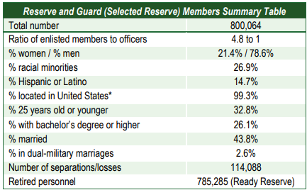
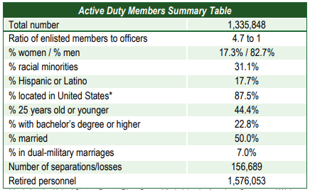
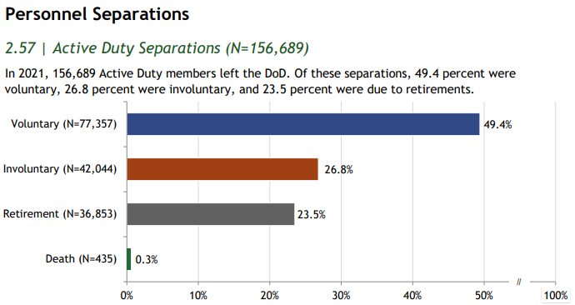
PIPELINE
Service Member Data – All Branches​
Total Size – 2,133,912 Service Members across all components​
Total Separations – 270,777​
72.9% of separations are Voluntary/Retirement
Most Reserve and Guard Service Members can be employed while active​
We need to find those who are the right fit for our industry!

Slide 5
POSITIONS
Field Engineers/Superintendants/Operations
Survey - Artillery
Safety – Infantry, EOD, Special Operations
Mechanics
Carpenters
Electricians
Welders

Slide 6
POTENTIAL PARTNERS
Notes:
SB- Program developed by the DoD and US Chamber of Commerce in 2014 (JTEST-A1) to help active-duty service members gain civilian experience and skills and aid in getting gainful employment after leaving Active Duty
Craft and Staff positions
90 – 180 day internship
Attract skilled military veterans earlyv before end of service date
Increase company visibility among military community
Access to diverse workforce with strong technical skills, leadership and problem-solving abilities
Train them our way
Low cost/risk on Kiewit
HoH- Program though the US Chamber of Commerce Foundation founded in March 2011.​ Goal is to help veterans, service members, and military spouses find meaningful employment.
Attending 14 events vs 5 events in 2022
Craft and Staff positions
20,000+ Attendees
Access to the HOH Employer Dashboard​
Access over 200,000 veteran and military spouse resumes​
Opportunity to directly engage with registered service members, and military spouses​
Participate on employer boards to highlight and educate about opportunities in construction and at Kiewit​
Automatic approval to all (20+) HOH events, bypassing any waitlist​
Sponsorship recognition at three hiring events
Army PaYS- The Partnership for Your Success (PaYS) Program is a strategic partnership between the U.S. Army and a cross section of corporations, companies, and public sector agencies. The Program provides America's Soldiers with an opportunity to serve their country while they prepare for their future. PaYS Partners guarantee Soldiers an interview and possible employment after the Army. This unique Program is part of the Army's effort to partner with America's business community and reconnect America with its Army.
SACC- The Service Academy Career Conference provides top-tier employment and academic opportunities exclusively to US Service Academy Graduates. Service Academy graduates are in demand for their expertise and leadership experience- not only by industry leading companies but also premier academic institutions.
Attending 3 events in 2023
this will help be an entry point to a talking point that even with these strong partnerships we’re forming, it will be very intensive work to find those people who are the best fit for Kiewit, provide them with a good onboarding experience, etc.

Slide 7
Resources
People
Lived Experience
Passion for this community
“Give Back” Mentality
Extreme Ownership
Time
These activities can be time intensive
Finance
Travel
Partner membership/cost
Sponsorships
ROI – 3 to 5 year commitment
Tracking progress
Program and Partner success
Candidate success
Notes:
SB- Program developed by the DoD and US Chamber of Commerce in 2014 (JTEST-A1) to help active-duty service members gain civilian experience and skills and aid in getting gainful employment after leaving Active Duty
Craft and Staff positions
90 – 180 day internship
Attract skilled military veterans earlyv before end of service date
Increase company visibility among military community
Access to diverse workforce with strong technical skills, leadership and problem-solving abilities
Train them our way
Low cost/risk on Kiewit
HoH- Program though the US Chamber of Commerce Foundation founded in March 2011.​ Goal is to help veterans, service members, and military spouses find meaningful employment.
Attending 14 events vs 5 events in 2022
Craft and Staff positions
20,000+ Attendees
Access to the HOH Employer Dashboard​
Access over 200,000 veteran and military spouse resumes​
Opportunity to directly engage with registered service members, and military spouses​
Participate on employer boards to highlight and educate about opportunities in construction and at Kiewit​
Automatic approval to all (20+) HOH events, bypassing any waitlist​
Sponsorship recognition at three hiring events
Army PaYS- The Partnership for Your Success (PaYS) Program is a strategic partnership between the U.S. Army and a cross section of corporations, companies, and public sector agencies. The Program provides America's Soldiers with an opportunity to serve their country while they prepare for their future. PaYS Partners guarantee Soldiers an interview and possible employment after the Army. This unique Program is part of the Army's effort to partner with America's business community and reconnect America with its Army.
SACC- The Service Academy Career Conference provides top-tier employment and academic opportunities exclusively to US Service Academy Graduates. Service Academy graduates are in demand for their expertise and leadership experience- not only by industry leading companies but also premier academic institutions.
Attending 3 events in 2023
this will help be an entry point to a talking point that even with these strong partnerships we’re forming, it will be very intensive work to find those people who are the best fit for Kiewit, provide them with a good onboarding experience, etc.

Slide 8
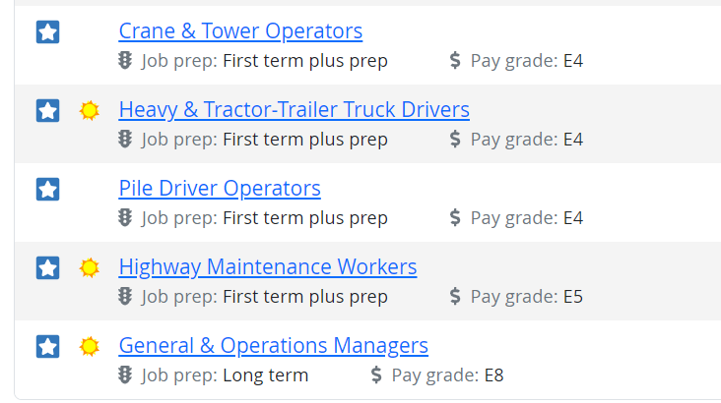
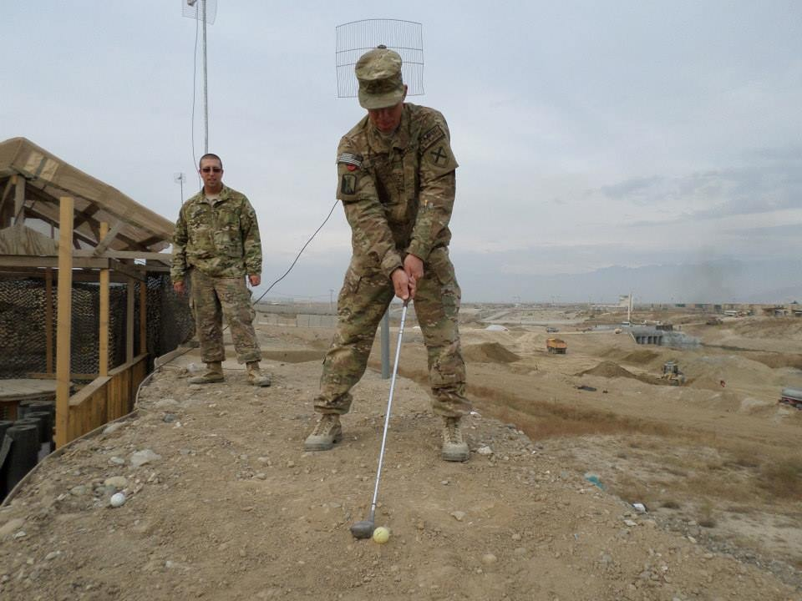
challenges
Challenges
Military Crosswalk Tools
Buyer beware!!! (12N – US Army Heavy Equipment Operator)
Level-set Expectations – These Resumes can get Crazy!
Salary
Transition time
Certification vs. Qualification

Slide 9
Military Friendly
Warfighter to Team Member
Mentorship
Career Path
Success!

Slide 10
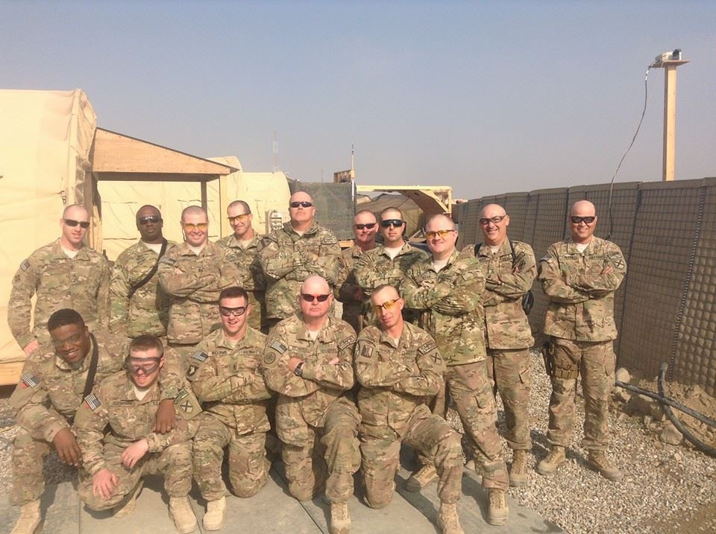
Questions?

